Slide 1
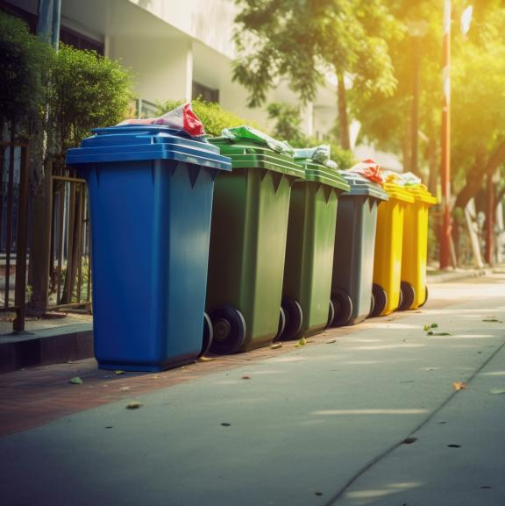

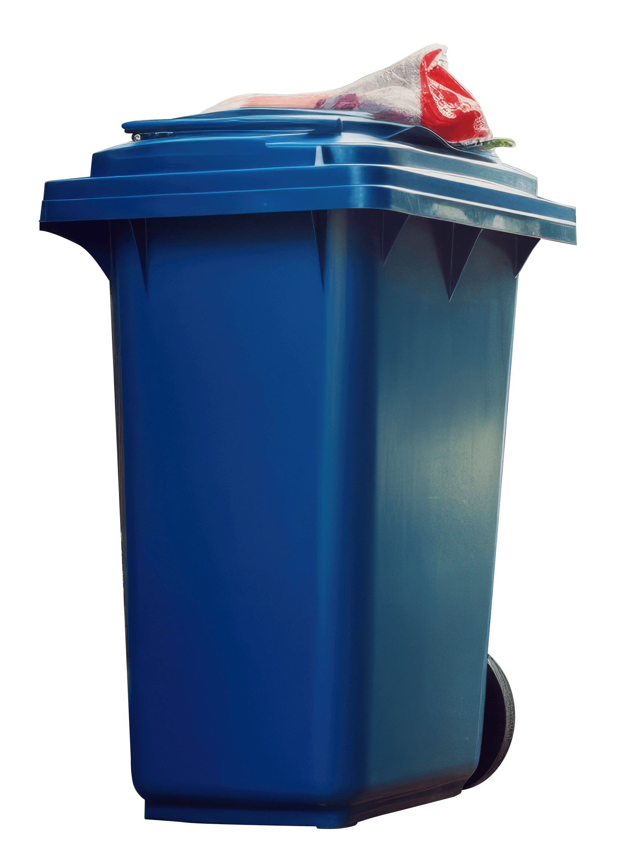
Reimagining Waste Segregation with AI
Smarter, Cleaner, and More Sustainable

Slide 2

The Waste Management Crisis: A Growing Challenge
Cities generate tons of waste daily
Improper segregation causes pollution, health issues, and landfill overflow
Manual segregation is inefficient and expensive
We need an intelligent, automated, scalable solution
Page 02

Slide 3
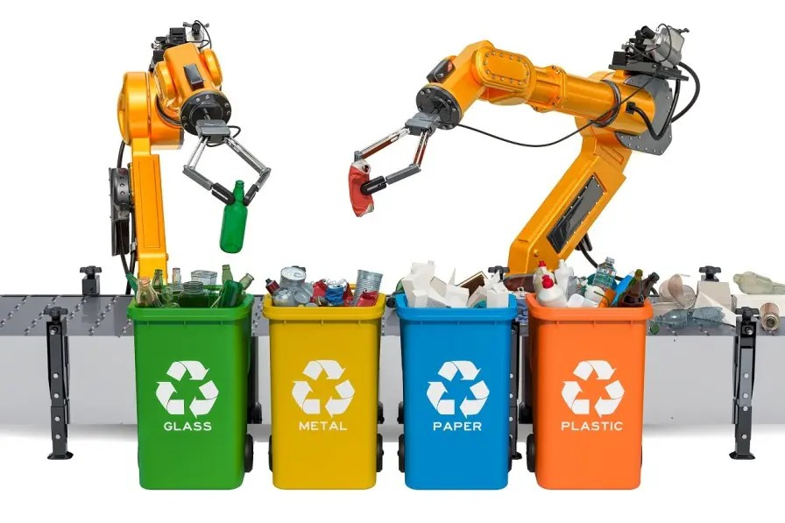
LLM-Based Agent Solution
Introducing an intelligent agent that uses Large Language Models (LLMs) to revolutionize waste management by addressing contamination at its source.
Primary Objective
Improve segregation and reduce downstream impact
Integrated Components
Advanced AI
LLM technology enables intelligent decision-making and continuous learning from waste management data
Automation Systems
Mechanical and digital automation enables precise and efficient waste sorting based on AI recommendations
Data Analytics
Real-time monitoring and analysis of waste patterns to optimize segregation processes and improve outcomes

Slide 4
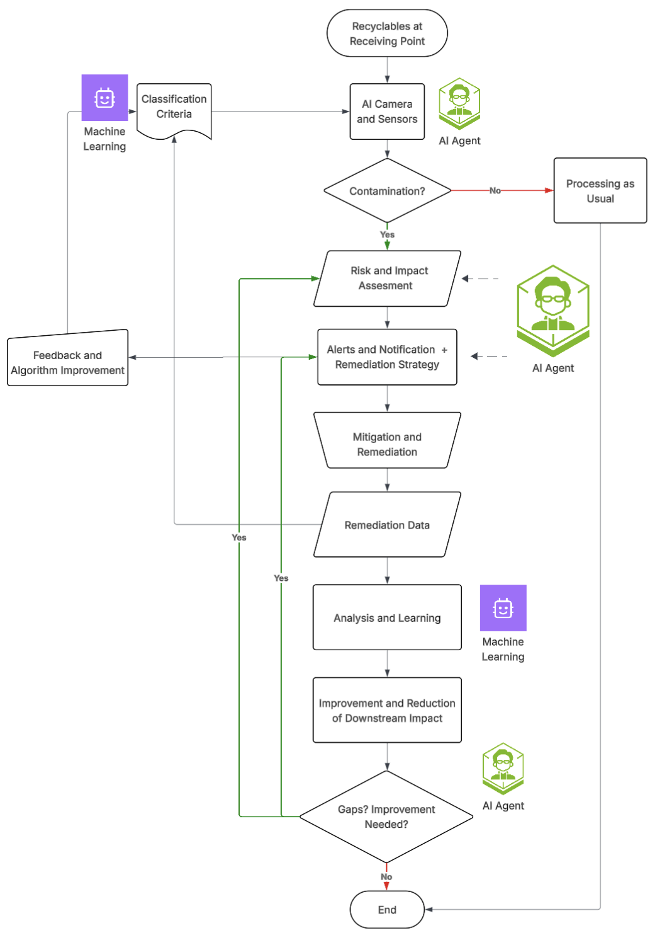
Smart Waste Contamination Management Workflow
Phase 1: Problem Identification
Phase 2: Classification
Phase 3: Risk & Remediation
Phase 4: Analytics & Learning
Phase 5: Improvement
4 / 11

Slide 5
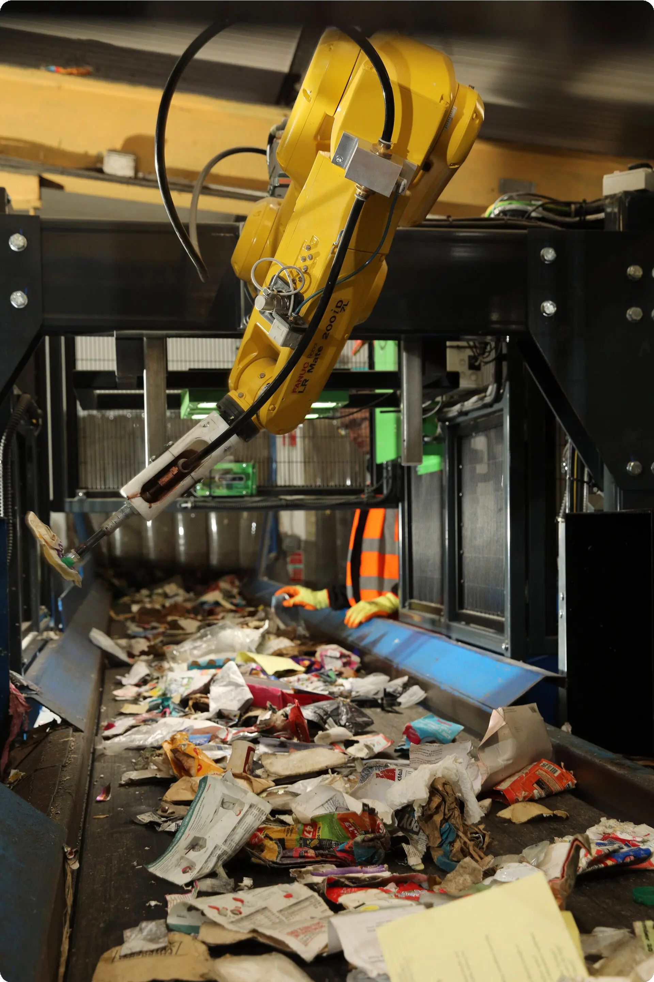
Phase 1 – Problem Identification
Uses sensors, cameras, or user input
Detects contamination presence
Triggers the classification engine

Slide 6
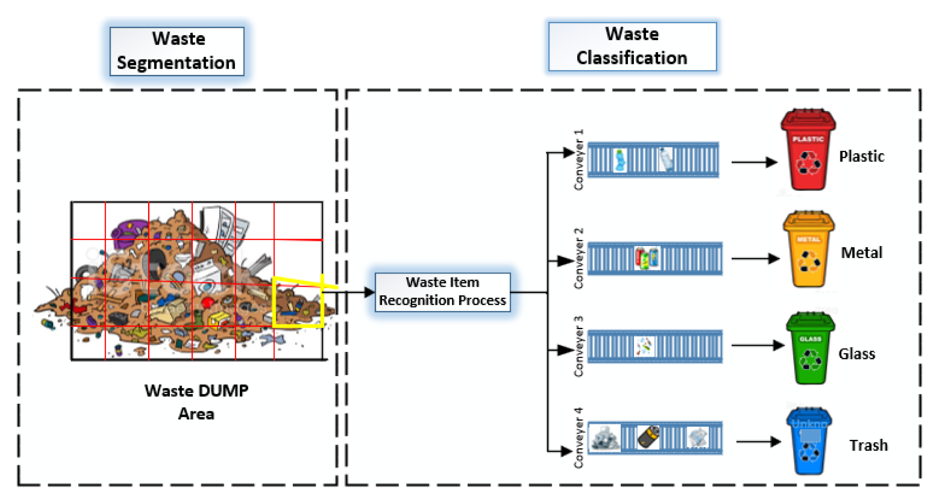
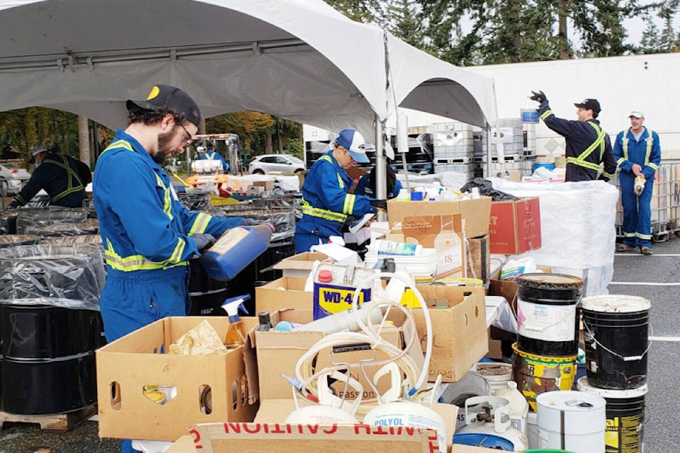
Phase 2 – Classification & Alerts
Phase 2a: Classifies waste (Yes/No)
Type: organic, plastic, hazardous, mixed material
Severity: low, medium, high
Phase 2a: AI evaluates how contamination will impact downstream processes such as recycling quality and cost efficiency.
Alerts for human intervention
Recommendation for Remediation

Slide 7
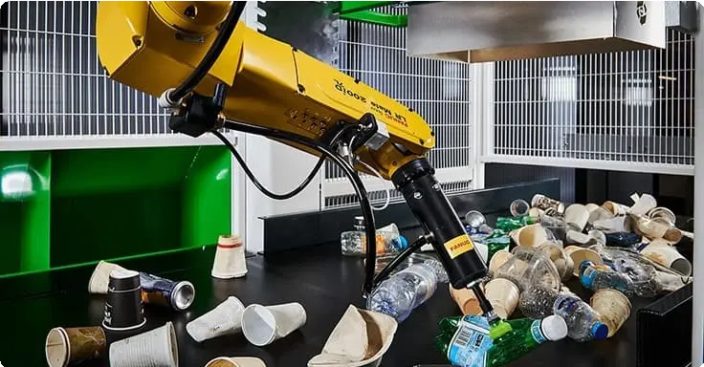
Phase 3 – Risk & Remediation
Phase 3a: Risk assessment of contamination severity
Phase 3b: LLM suggests corrective/preventive actions
Examples: Rerouting, Cleaning, Alert escalation

Slide 8
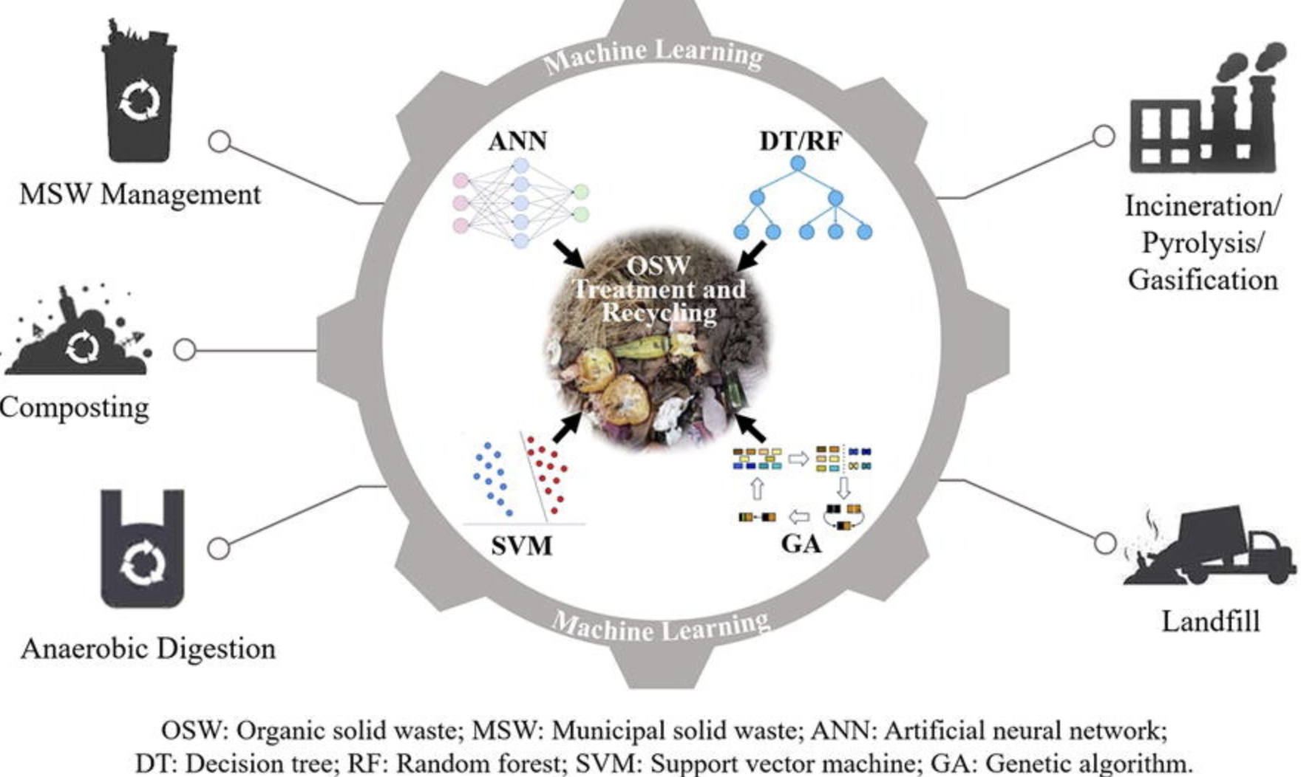
Phase 4 – Analytics & Learning
Tracks trends, root causes, and outcomes
Extracts actionable insights
Continuously learns and adapts

Slide 9

Phase 5 – Continuous Improvement
Feedback loop enhances decision-making
Reduces upstream contamination
Optimizes system for long-term impact

Slide 10
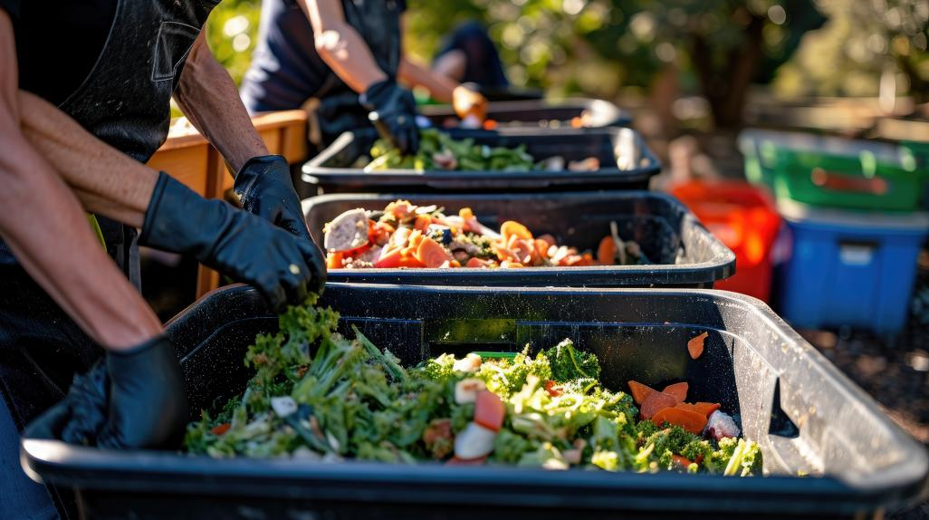





Benefits
Increased Segregation Efficiency
Efficient Remediation actions
Supports data driven governance
Real time alerting & response
Smarter Decision making via analytics

Slide 11

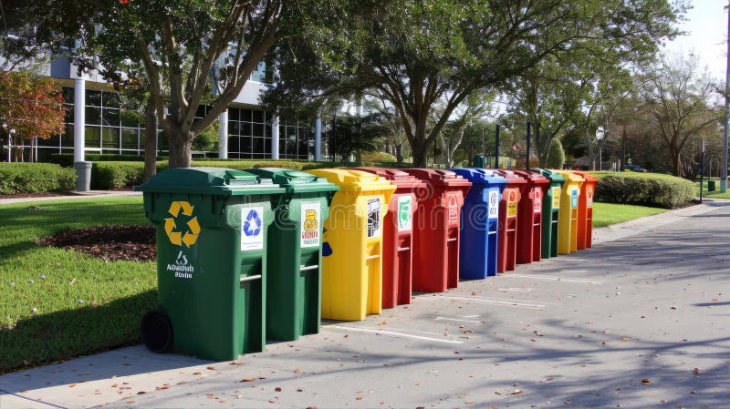
The Future of Clean Cities
Let’s build smarter, cleaner cities using intelligent waste systems. Together, we can make sustainability scalable and actionable.

